Slide 1
FOOD TRENDS:
Based on Customer Satisfaction
TEAM-05
Under the Guidance:
Pavithra Kannan mam

Slide 2
Name- Dipa Majumder

Slide 3
Sentiment Analysis Dashboard – Contribution
Visualization and Insights Created:-
1. Donut Chart – Total Reviews by Sentiment Category
Displays the overall distribution of customer feedback as Positive, Negative, and Neutral.
Helps in quickly understanding the overall customer sentiment trend.
Shows exact counts and percentages for each sentiment type, giving a clear visual summary of sentiment spread.
2. Bar Chart – Sentiment by Visit Frequency
Compares how sentiment changes with visit frequency (Weekly, Monthly, Rarely, Daily).
Helps identify loyal vs casual customers’ sentiment patterns — for example, frequent visitors may have more positive feedback.
This visualization adds deeper insights beyond just total review counts.

Slide 4
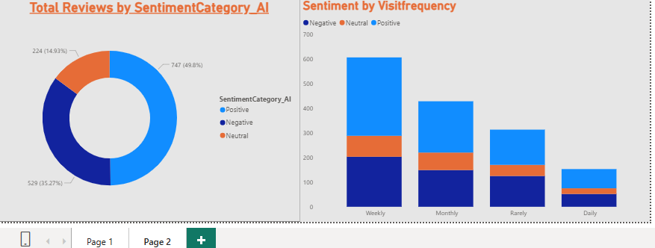
OUTPUT

Slide 5
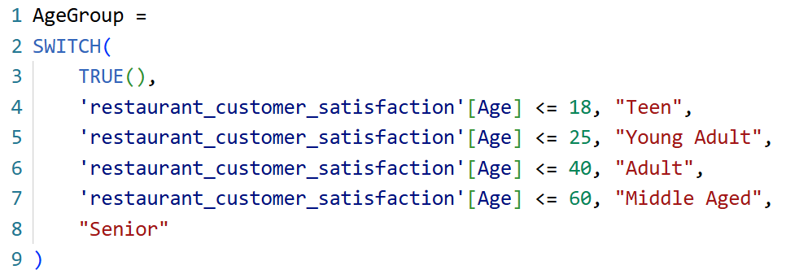
DAX Formula for Age Group Classification
Creating Dynamic Age Groups Using DAX:-
1. To make the analysis more insightful, I created a new calculated column called AgeGroup using a DAX formula.
2. This formula automatically classifies customers into meaningful age categories — Teen, Young Adult, Adult, Middle Aged, and Senior — based on their age.

Slide 6
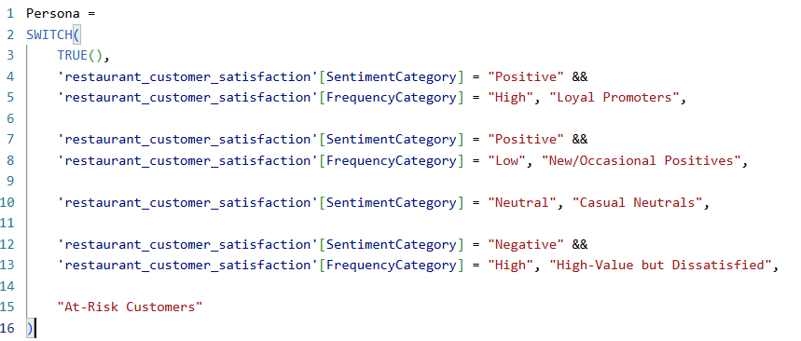
Customer Persona Dashboard
[2] Persona column:
Segments customers into actionable personas based on sentiment and visit frequency, including Loyal Promoters, New/Occasional Positives, Casual Neutrals, High-Value Dissatisfied, and At-Risk Customers. The categorization logic is presented in the formula image for clarity.

Slide 7
Power BI Visual Built
This dashboard visualizes customer personas, cuisines, and demographics using Power BI.
The aim was to understand customer distribution, identify high-value segments, and analyze satisfaction trends
visuals:
Top Cards:
  Total Customers (1500) → Total number of unique customers in the dataset.
  Average Rating (3.01) → Overall customer satisfaction score.
Donut Chart (Top Left):
Shows customer segmentation by persona — like At-Risk, Casual, Loyal Promoters, etc.
→ Helps identify which type of customers dominate the business.
Bar Chart (Bottom Left):
Shows Cuisine vs Persona → which cuisines attract loyal or at-risk customers.
Bar Chart (Bottom Right):
Shows Age Group vs Persona → which age groups are more likely to be loyal or at-risk.

Slide 8
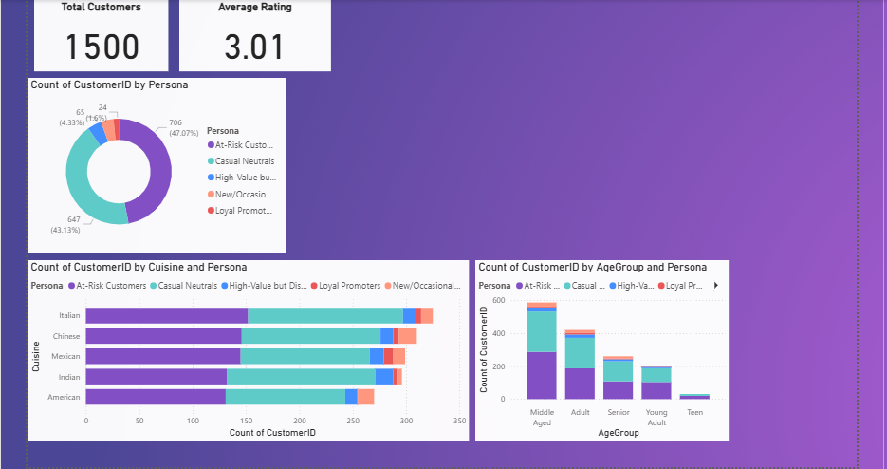
  OUTPUT:

Slide 9
CONCLUSION
During my internship, I developed interactive dashboards in Power BI to analyze customer personas, demographics, and satisfaction trends.
I created custom DAX formulas such as the Age Group calculation to categorize customers and enhance the depth of insights.
The dashboards helped identify key patterns — for example, most customers were At-Risk or Casual, with the Adult and Middle-Aged segments being the most active.
Through this project, I gained hands-on experience in data visualization, DAX scripting, and business analytics.
I learned how to convert raw data into meaningful insights and present them effectively through visual storytelling.
Overall, this experience improved my technical, analytical, and presentation skills, helping me understand how data supports real-world decision-making.

Slide 10
THANK YOU

